Slide 1
Digital method of the month: GIS
Centre for Data, Culture & Society
16/10/2023 (1200-1400)

Slide 2
Today's Schedule
12:00-12:10 Housekeeping and intro
12:10-12:25 Round of Presentation of the attendees + brief intro of those who said they would be happy to talk
12:25 –12:50 discussion using this document
12:50-13:00 discuss available resources, way forwards and wrapping up

Slide 3
What is GIS?
The floor is yours…

Slide 4
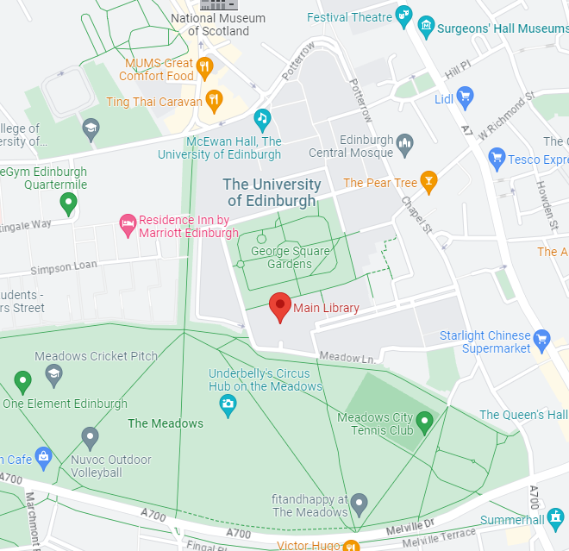
What is GIS?
The use of GIS in humanities and social science projects is a long-established practice.
Using a GIS system can help to create better analysis of studied interactions and phenomena. Maps are able to bring together different informative layers generating additional knowledge where the informative potential exceeds the sum of the single information.
LAT, LON
55.94296580140858, -3.189185903615852
GIS
Geographical = spatial location
Information = data attached to spatial location
System = everything to work towards a goal (hardware, networks, software, data)
Example question: Where can I study on the main campus?
It’s a library
Not a giant car park (although it looks like one)

Slide 5
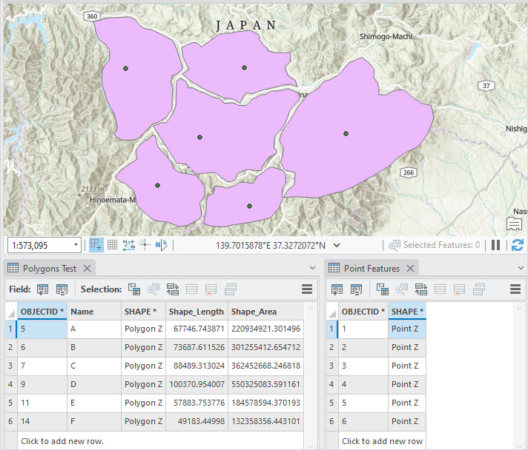
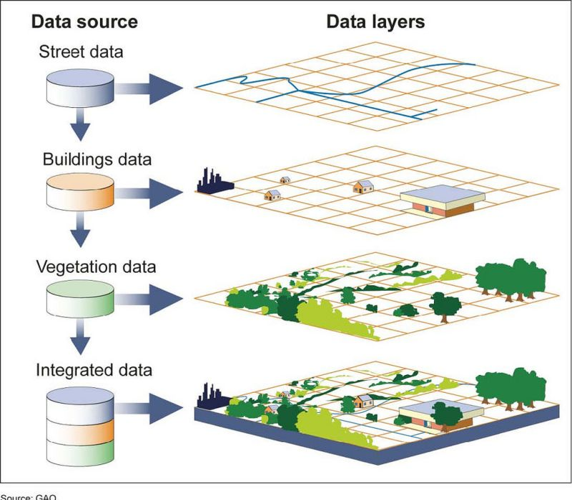
What is GIS?
GIS can also help a researcher cross disciplinary boundaries when working on an interdisciplinary project or question. The use of GIS platform can be synthesised into 4 steps:
Create geographic data.
Manage it.
Analyze it and gather a better knowledge of the area as a whole system
Display it on a map.

Slide 6
Concept to get familiar with
Raster vs Vector
Cartography principles and RS
Shapefiles and their formats (e.g. dxf)
Spatial analysis algorithms (Qgis, ArcGIS)
OSM and WMS services
Databases
Image processing: NDVI, DEM and others
Topology
Extensions and Plugins

Slide 7
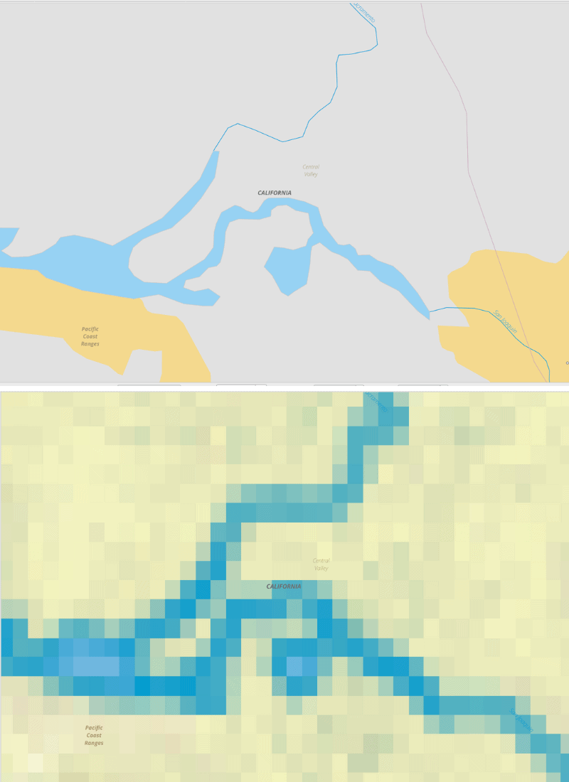
Raster vs Vector
Raster
Many grids across an area.
Arbitrary value assigned to a grid.
Pixelation happens at an inappropriate scale.
Vector
Point, line, polygons
At least one or multiple points
Representation by running lines through points
No pixelation, regardless you zoom in and out.

Slide 8
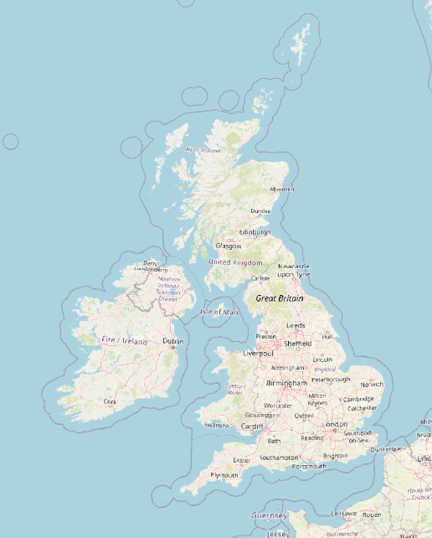
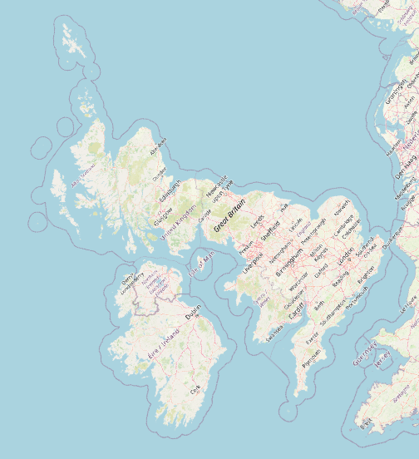
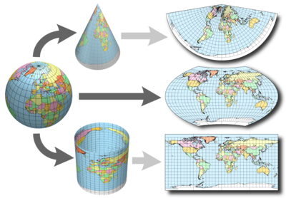
CRS = Coordinate Reference System
EPSG:2263 for the UK
2263 is supposed to be for New York
3D to 2D transformation
Geographically-specific to minimise distortion
EPSG:27700 for the UK

Slide 9
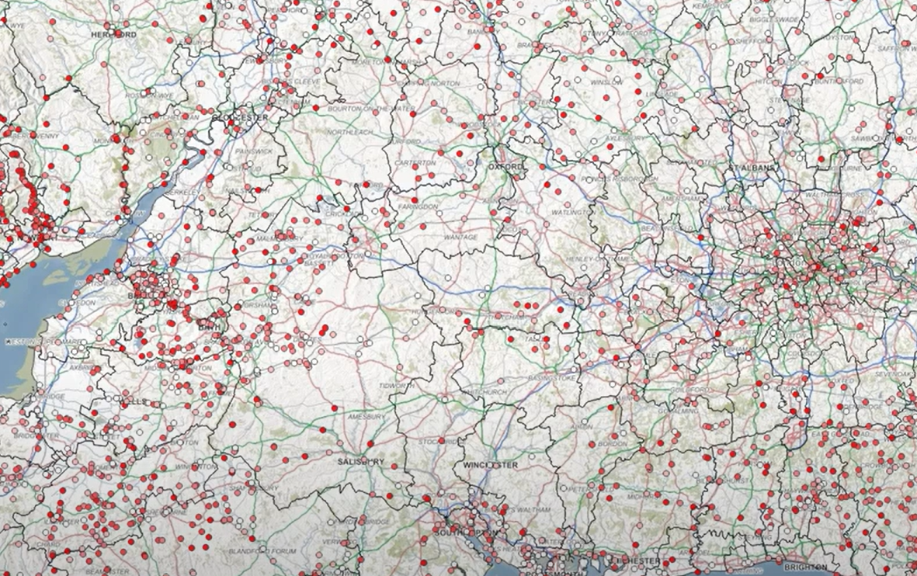
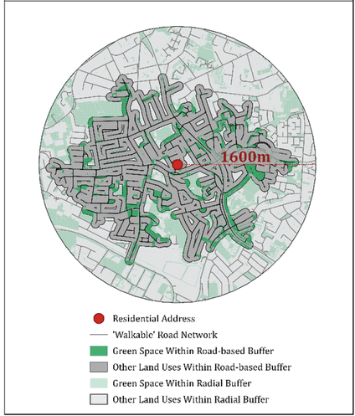
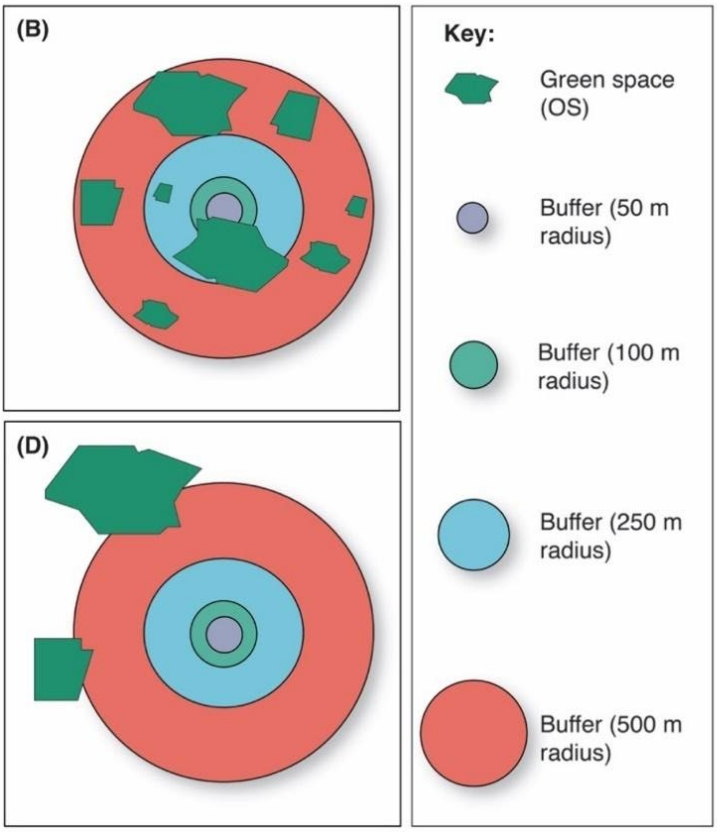
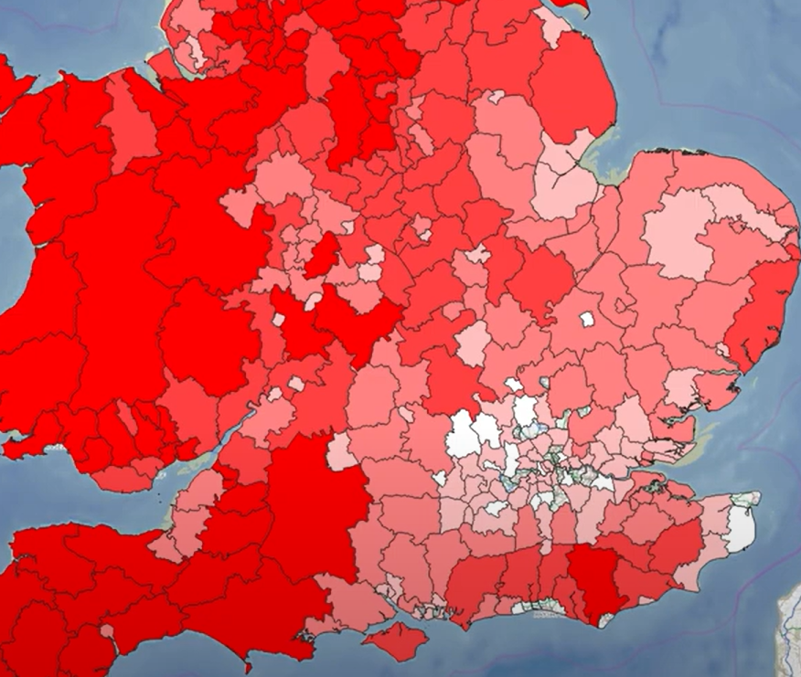
Spatial analysis algorithms (Qgis, ArcGIS)

Slide 10
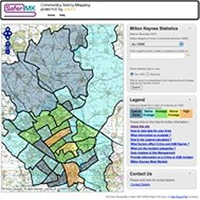
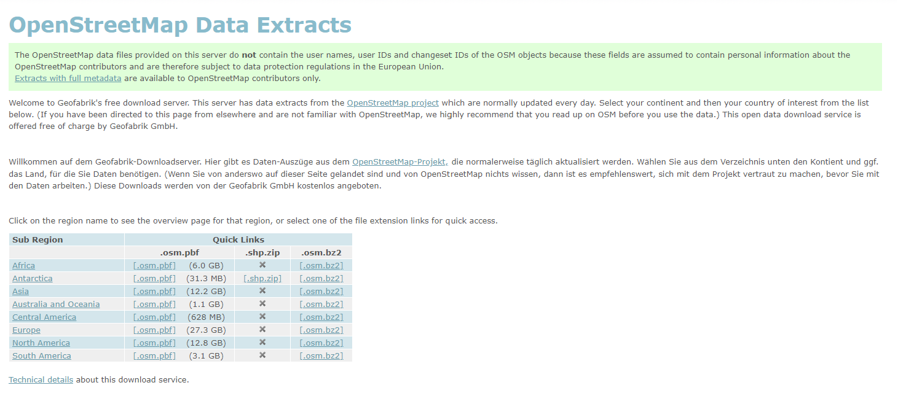
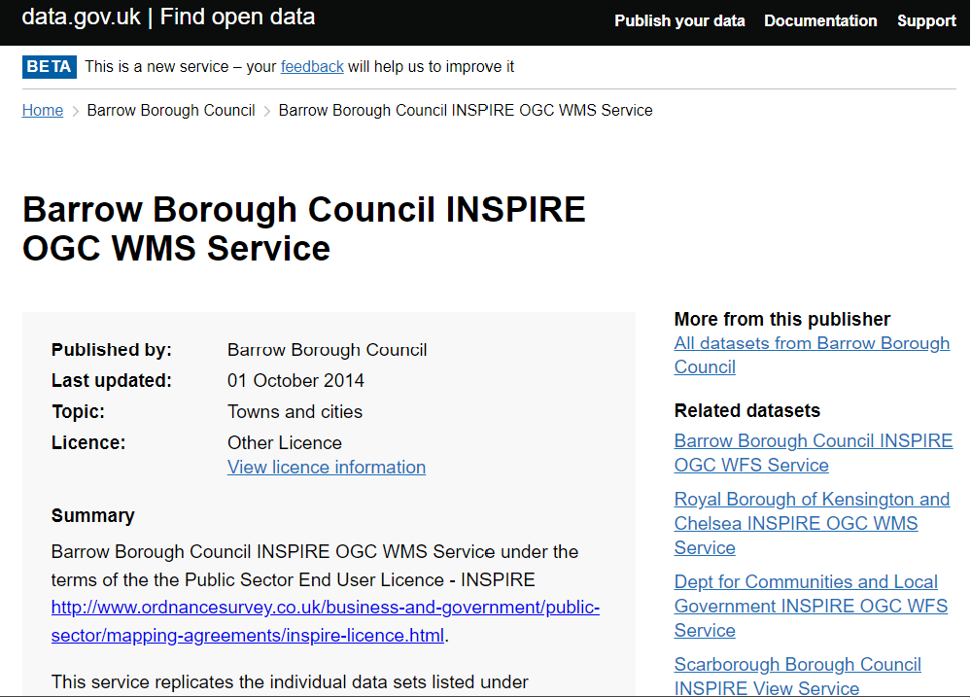
OSM and WMS

Slide 11
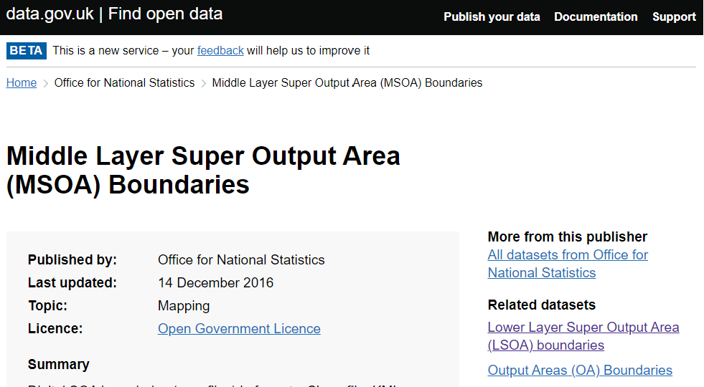
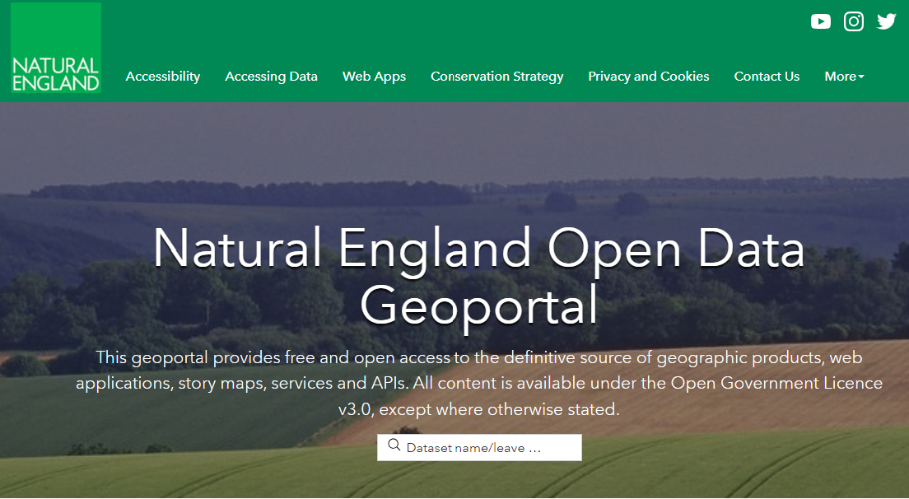

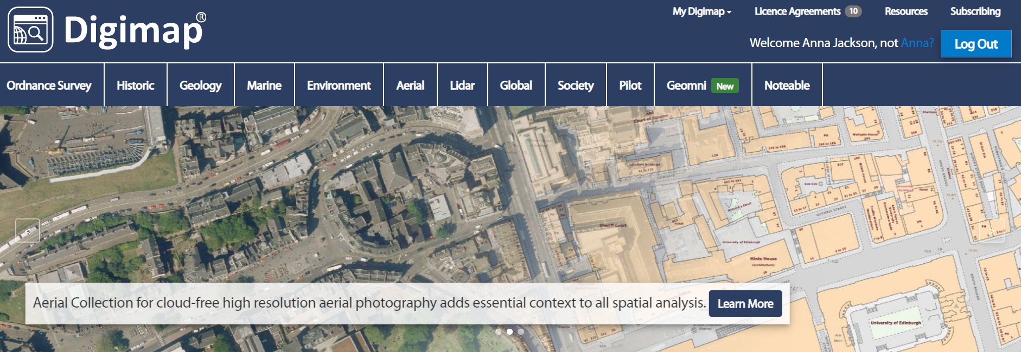

Databases

Slide 12
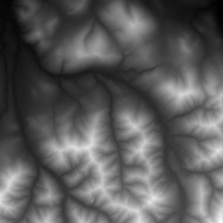
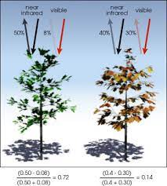
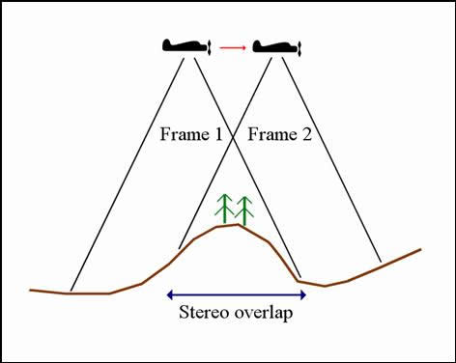
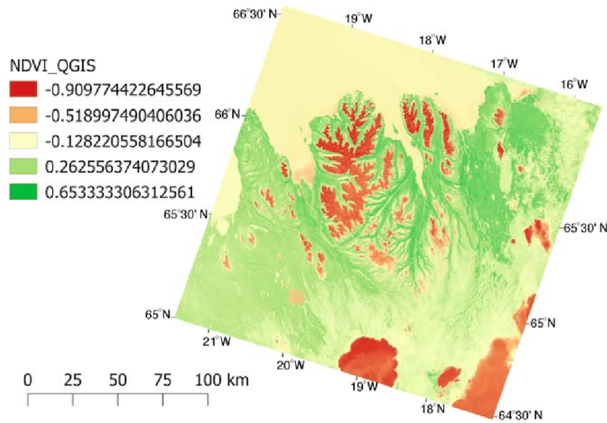
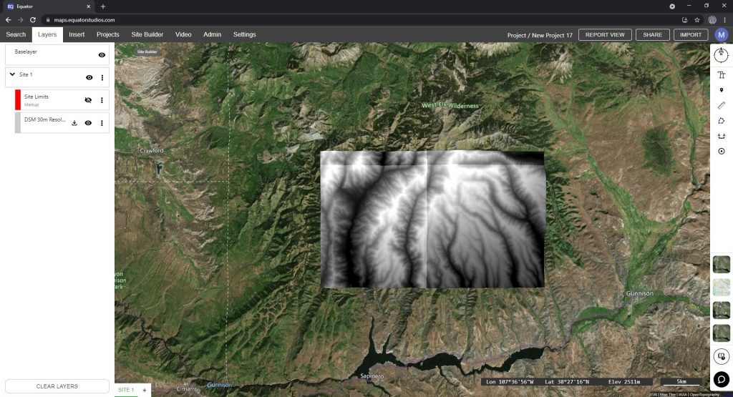
Image processing: NDVI, DEM

Slide 13
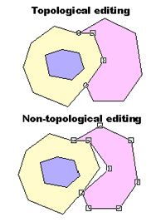
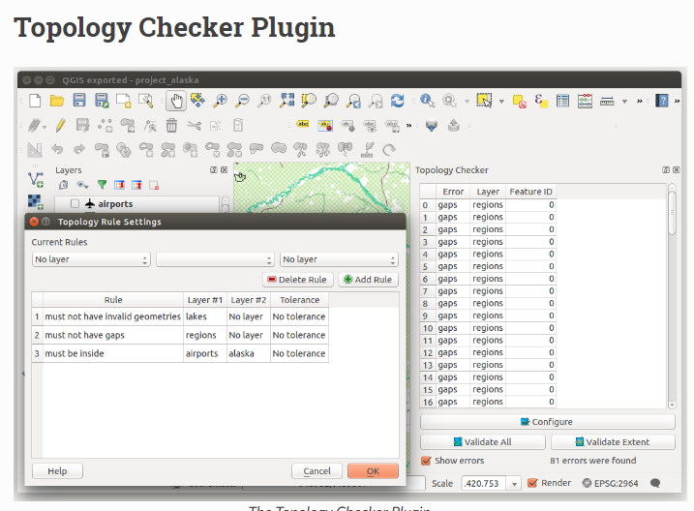
Topology
Nowadays, it’s so much simpler…

Slide 14
Time
How much will it take to learn?
Skills-based goals are critical
Basic skills: Find, store, style, display and export geospatial information
Intermediate: Perform geoprocessing (e.g. spatial joins, subsetting geospatial data)
Advanced: Advanced geospatial analysis (cluster analysis, aggregating geospatial data, integration with R or Python)
Personal experience only… (let’s say you work full time 9-5, Monday to Friday)
Zero to basic: 1-3 months
Basic to Intermediate: 3-9 months
Intermediate to Advanced: 6 months plus…

Slide 15
Time
Is it possible to self-learn?
Yes! I did that myself. All you need is a bit of motivation…
Therefore, find a project…
Where are the best room or flat deals in Edinburgh?
Which charity shop in Edinburgh has the faster restock for pricey, branded items?
Shortest way from home to university with the least exposure to air and noise pollution?
Paths where I could take to increase the chance to see a cute dog?

Slide 16
Easy Pitfalls
Chose the wrong RS or failing to set a RS.
Not seeing anything in the interface
Britain looks fatter than its typical size
Topology errors (mostly if importing data from other systems as CAD)
Move Project on different PC or moving files from their original location to another or simply sharing data with others
Proprietary extensions of files
Fail to retrieve data after closing the interface

Slide 17
The Big Questions
GIS vs WebGIS
Implementation with other software (R, Python, 3D managing software, CAD, photogrammetry software)
How to work collaboratively
Managing 3D Data

Slide 18


Softwares
Two main players:
QGis
ArcGis
https://gisgeography.com/qgis-arcgis-differences/

Slide 19
Softwares
Other free software
GRASS GIS – Geospatial data management, vector and raster manipulation - developed by the U.S. Army Corps of Engineers (Qgis now has a Grass Plugin)
gvSIG – Mapping and geoprocessing with a 3D rendering plugin
ILWIS (Integrated Land and Water Information System) – Integrates image, vector and thematic data.
JUMP GIS / OpenJUMP ((Open) Java Unified Mapping Platform) – The desktop GISs OpenJUMP, SkyJUMP, deeJUMP and Kosmo all emerged from JUMP.
MapWindow GIS – Free desktop application with plugins and a programmer library
SAGA GIS (System for Automated Geoscientific Analysis) – Tools for environmental modeling, terrain analysis, and 3D mapping
uDig – API and source code (Java) available.
Other commercial software
Autodesk – Some GIS features implemented but was not born as a GIS system.
Bentley Systems – Products that interface with its flagship MicroStation software package include Bentley Map and Bentley Map View.
ENVI – Utilized for image analysis, exploitation, and hyperspectral analysis.
ERDAS IMAGINE by ERDAS Inc – Products include Leica Photogrammetry Suite, ERDAS ER Mapper, ERDAS ECW/JP2 SDK (ECW (file format)) are used throughout the entire mapping community (GIS, Remote Sensing, Photogrammetry, and image compression) and ERDAS AP

Slide 20
Where to Search for Help
https://gis.stackexchange.com/
https://qgis.org/en/site/forusers/support.html
https://pro.arcgis.com/en/pro-app/help/main/welcome-to-the-arcgis-pro-app-help.htm

Slide 21
Resources to learn GIS
GIS AND SOCIAL SCIENCES AND HUMANITIES BOOKS AVAILABLE AT THE UNI LIBRARY
Steinberg, Steven J & Steinberg, Sheila L, 2005. Geographic Information Systems for the Social Sciences, Los Angeles: SAGE Publications Inc.
Thomas Coomans ; Bieke Cattoor ; Krista De Jonge, 2019. Mapping Landscapes in Transformation, Leuven University Press
Dunn, S., 2019. A History of Place in the Digital Age, Milton: Taylor & Francis Group. Dunn, S., 2019. A History of Place in the Digital Age, Milton: Taylor & Francis Group.

Slide 22
Resources to learn GIS
SELF LEARNING
Good Introductory course https://www.linkedin.com/learning/learning-qgis-2/exploring-the-powerful-world-of-qgis?u=50251009
If you are going to use QGIS its manual is available online and cover a lot https://docs.qgis.org/3.10/en/docs/user_manual/
And also a lot of embedded tutorials https://docs.qgis.org/3.10/en/docs/training_manual/
And a basic intro https://docs.qgis.org/3.10/en/docs/gentle_gis_introduction
Another basic video that has a good intro on projections and RS https://www.youtube.com/watch?v=kCnNWyl9qSE In general Youtube is a good place to find a lot of video tutorial both on the general principles and on specific topics
List of ESPG codes https://spatialreference.org/ref/epsg/
https://datacarpentry.org/geospatial-workshop/

Slide 23
Resources To Learn GIS
CDCS LIVE UPCOMING TRAINING ON GIS
24/11/22-08/12/22 Introduction to QGIS and Geospatial Data/
More to come on the second Semester (Webgis, Geographical Data analysis with R, Geospatial Data Visualsiation etc..)
OTHER LIVE TRAINING WITHIN THE UNIVERSITY
Introduction to Visualising Data in QGIS (Research Data Service Training) Currently not live
https://www.ed.ac.uk/information-services/research-support/research-data-service/training
Digimap https://digimap.edina.ac.uk/
Digital Research Service: Introduction to visualising data in arcgis (currently not live) https://www.digitalresearchservices.ed.ac.uk/training/introduction-to-visualising-data-in-arcgis
BLOGS
http://wiki.gis.com/wiki/index.php/List_of_GIS-related_Blogs

Slide 24
Feedback
https://forms.office.com/r/YYNrqvuNr8

